Slide 1

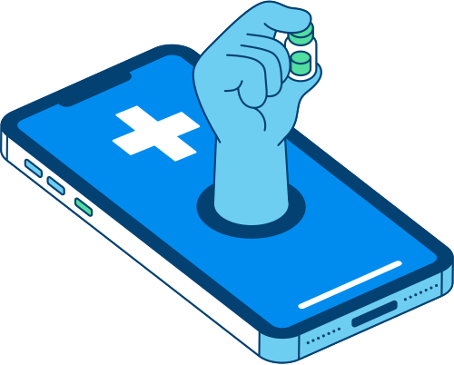





DOSE
GUIDE
Peace of mind in every pill—your trusted partner for medication care
Abhay Shrirangkumar Naik
Pavan Thaloor Yogendrakumar
Rudra Dalwadi
Sree Reshma Paramel
Rashmi Daga
FALL 2024

Slide 2


VISION
Mission: Simplify medication management for seniors and caregivers
Value Proposition: DoseGuide offers reliable tracking, pharmacy integration, and caregiver alerts for seamless medication adherence
FALL 2024

Slide 3


UNMET NEEDS
SENIORS
Anxiety from managing complex medication schedules
CAREGIVERS
Stress managing multiple patients’ schedules and refills
PROFESSIONALS
Missed doses due to busy schedules
FALL 2024

Slide 4

CUSTOMER SEGMENTS
With our service running, we tailor our app's features and functionalities to better address their specific challenges and improve their overall medication management experience.
PRIMARY
SECONDARY
Working professionals with health routines
Tech-savvy users providing feedback for refinement
Seniors
Caregivers
FALL 2024

Slide 5

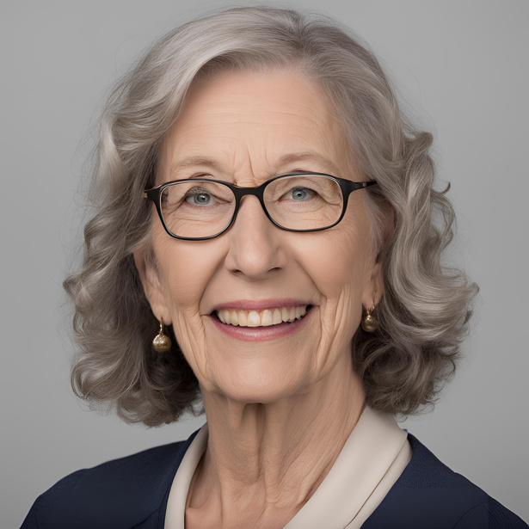
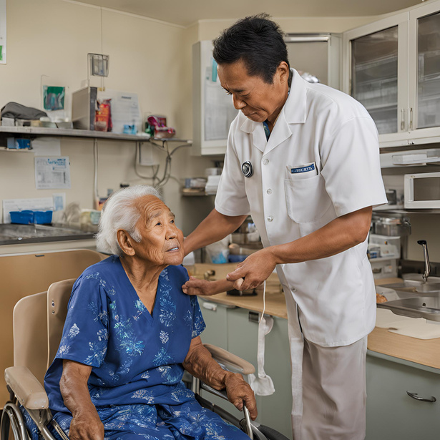

DOSEGUIDE
USE CASES
Medication Reminders for Seniors
Caregiver Alerts for Elderly Patients
Flexible Reminders for Busy Professionals
EMILY (RETIRED LIBRARIAN)
JACOB (CAREGIVER)
BALU (ACCOUNT MANAGER)
Forgets if she’s taken her medications and worries about refills.t
Needs assurance that elderly patients take medications on time.
Busy work schedule leads to missed doses.
FALL 2024

Slide 6


COMPETIVE ANALYSIS
MediSafe : No deep integration with pharmacies, caregiver support is limited to premium features.
CareZone : Lacks real-time pharmacy integration, no inventory tracking for medication levels
Apple Health : No specific medication reminders, doesn’t connect with pharmacies or caregivers
PillPack : Limited real-time tracking for doses, no caregiver notifications.
ScriptHero : No daily medication reminders, limited adherence tracking features
FALL 2024

Slide 7





MARKET SIZE
This revenue potential highlights strong market demand for accessible and reliable medication management solutions among seniors in Massachusetts, with significant opportunities for growth by expanding to other regions and incorporating caregiver support.
TARGET
POTENTIAL USERS
REVENUE
Massachusetts’ 1.2M seniors, 850K caregivers
Estimated 240,000 adopters at 40% penetration
$1.2M monthly
FALL 2024

Slide 8


RISKS/DEPENDENCIES
01
Data Privacy : Implement end-to-end encryption; adhere to GDPR, HIPAA
Legal Issues : Conduct thorough patent searches, license technology
02
Third-Party Dependencies : Maintain multiple pharmacy partnerships; create backup systems
03
04
Tech Adoption : Focus on intuitive design and tutorials tailored for seniors
FALL 2024

Slide 9
DOSEGUIDE
THANK YOU
FALL 2024

